Slide 1
NETWORK-LAYER SERVICES

Slide 2
NETWORK-LAYER SERVICES
Internet is made of many networks (or links) connected through the connecting devices.
Internet is an internetwork, a combination of LANs and WANs

Slide 4
Functions of Network Layer
It translates logical network address into physical address. Concerned with circuit, message or packet switching.
Routers and gateways operate in the network layer. Mechanism is provided by Network Layer for routing the packets to final destination.
Connection services are provided including network layer flow control, network layer error control and packet sequence control.
Breaks larger packets into small packets.

Slide 5
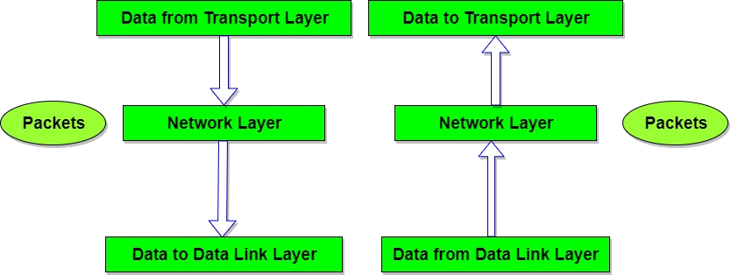

Slide 6
Services
Packetizing : to carry a payload from the source to the destination without changing it or using it
Routing and Forwarding :
Routing is responsible for routing the packet from its source to the destination
Forwarding : If routing is applying strategies and running some routing protocols to create the decision-making tables for each router

Slide 7
Other Services
Error Control
Flow Control
Flow control tells the sender how much data should be sent to the receiver so that it is not lost. This mechanism makes the sender wait for an acknowledgment before sending the next data. There are two ways to control the flow of data:
Stop and Wait Protocol
Sliding Window Protocol
Congestion Control
Quality of Service
Security

Slide 8
Congestion Control
When too many packets are transmitted through a network, congestion occurs At very high traffic, performance collapses completely, and almost no packets are delivered

Slide 9
PACKET SWITCHING
data communication switching techniques are divided into two broad categories,
circuit switching - is used at the physical layer; the electrical switch mentioned earlier is a kind of circuit switch.
packet switching - only packet switching is used at the network layer because the unit of data at this layer is a packet.

Slide 10
PACKET SWITCHING
packet-switched network can use two different approaches to route the packets:
The datagram approach and
the virtual circuit approach.

Slide 11
Datagram Approach: Connectionless Service
When the network layer provides a connectionless service, each packet traveling in the Internet is an independent entity;
there is no relationship between packets belonging to the same message.
The switches in this type of network are called routers.
A packet belonging to a message may be followed by a packet belonging to the same message or to a different message.

Slide 12
In the datagram approach, the forwarding decision is based on the destination address of the packet

Slide 14
Virtual-Circuit Approach: Connection-Oriented Service
In a connection-oriented service (also called virtual-circuit approach), there is arelationship
between all packets belonging to a message.
Before all datagrams in a message can be sent, a virtual connection should be set up to define the path for the datagrams.
After connection setup, the datagrams can all follow the same path.

Slide 15
Virtual-Circuit Approach: Connection-Oriented Service
the packet contain the source and destination addresses, it must also contain a flow label, a virtual circuit identifier
Setup Phase - a router creates an entry for a virtual circuit
Request packet - is sent from the source to the destination. This auxiliary packet carries the source and destination addresses.
Acknowledgment Packet - special packet, called the acknowledgment packet, completes the entries in the switching tables.
Data-Transfer Phase - After all routers have created their forwarding table for a specific virtual circuit, then the network-layer packets belonging to one message can be sent one after another.

Slide 16
In the virtual-circuit approach, the forwarding decision is based on the label of the packet.

Slide 21
NETWORK-LAYER PERFORMANCE
The performance of a network can be measured in terms of delay, throughput, and packet loss.
Delay - All of us expect instantaneous response from a network, but a packet, from its source to its destination, encounters delays.
The delays in a network can be divided into four types:
transmission delay,
propagation delay,
processing delay, and
queuing delay.
Throughput
Packet Loss
Congestion Control

Slide 22
Transmission Delay
A source host or a router cannot send a packet instantaneously.
A sender needs to put the bits in a packet on the line one by one.
If the first bit of the packet is put on the line at time t₁ and the last bit is put on the line at time t₂, transmission delay of the packet is (t₂ − t₁).

Slide 23
Propagation Delay
Propagation delay is the time it takes for a bit to travel from point A to point B in the transmission media.
The propagation delay for a packet-switched network depends on the propagation delay of each network (LAN or WAN).
The propagation delay depends on the propagation speed of the media

Slide 24
Processing Delay
The processing delay is the time required for a router or a destination host to receive a packet from its input port, remove the header, perform an error detection procedure, and deliver the packet to the output port (in the case of a router) or deliver the packet to the upper-layer protocol (in the case of the destination host).

Slide 25
Queuing Delay
Queuing delay can normally happen in a router
router has an input queue connected to each of its input ports to store packets waiting to be processed;
the router also has an output queue connected to each of its output ports to store packets waiting to be transmitted.
The queuing delay for a packet in a router is measured as the time a packet waits in the input queue and output queue of a router.

Slide 26
Total Delay

Slide 27
Throughput
Throughput at any point in a network is defined as the number of bits passing through the point in a second, which is actually the transmission rate of data at that point.
In a path from source to destination, a packet may pass through several links (networks), each with a different transmission rate.

Slide 28
Packet Loss
When a router receives a packet while processing another packet, the received packet needs to be stored in the input buffer waiting for its turn.
A router, however, has an input buffer with a limited size. A time may come when the buffer is full and the next packet needs to be dropped.

